Slide 1
First Day Information

Slide 2
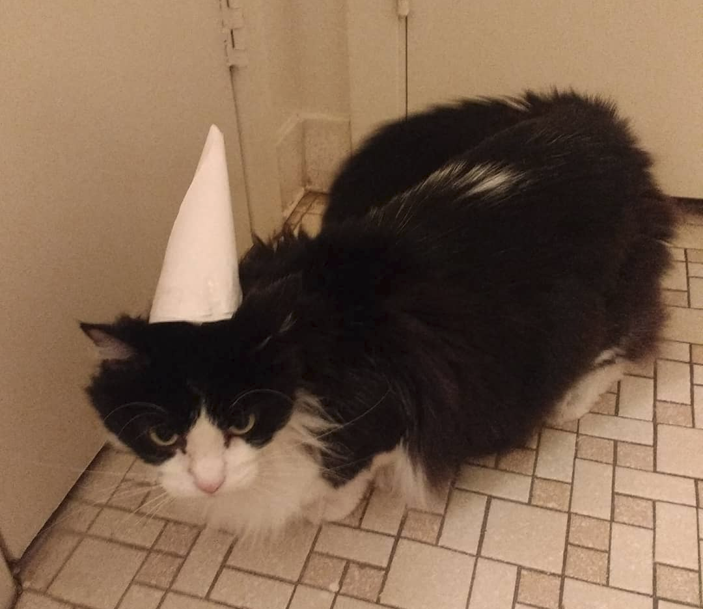
Who is this person?
Dr. Maxwell
Cognitive Psychologist
  Memory!
  Language!
  Attention!

Slide 3
Contacting Me
How to contact me:
Email: nicholas.maxwell@msutexas.edu
  Please put course # and section # in header!
  24 – 48 hours (except on weekends)
In person! OD 118
Fall 24 Office hours: MWF: 10-11am; F: 2-4pm

Slide 4
What do I get out of this Class?
Cognition and behavior as they naturally occur in a social context
Research methods that used to investigate questions in Social Psychology
Current directions and trends within the field of Social Psychology

Slide 5

What will I Need?
Textbook: Social Psychology by Saul Kassin, Steven Fein, & Hazel Rose Markus (12th Edition) (2024)
Something to take notes with
Yourself!

Slide 6
What’s expected of you
4 Exams (1oo pts each)
14 Chapter quizzes (open-note/open book)
  Lowest quiz grade dropped
Attendance/Participation

Slide 7
Important Dates
Questions so far?

Slide 8
Your Turn!
Name:
Major:
Where you’re from (city/state):
Why are you taking this class/what do you hope to gain from it?

